Slide 1
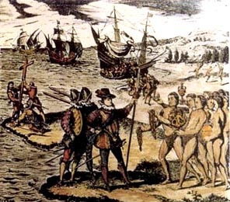
The Columbian Exchange

Slide 2
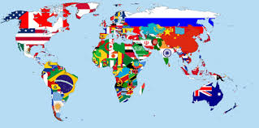
DIFFUSION OF CULTURE
Diffusion: To spread something about. To move it!
Cultural Diffusion: The movement of cultural traits (objects, ideas, behaviors, language) from one society to another.
Diffusion is an EXCHANGE between cultures

Slide 3
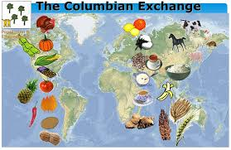
The Columbian Exchange: An example of Diffusion of culture
Age of Exploration opens the door between two different hemispheres on our planet.
The movement of goods and ideas between the two will change the world into the one you know today!

Slide 4
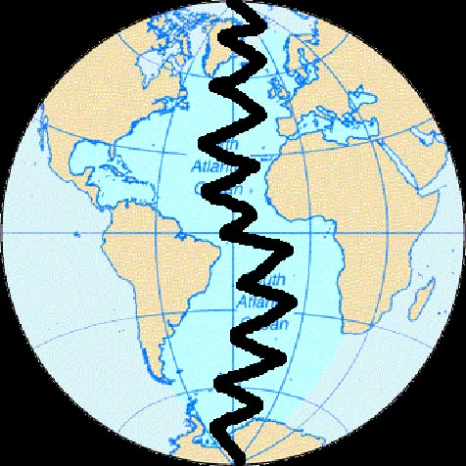
Before 1492
Two very different ecosystems
Two sets of culturally diverse peoples
Two different disease pools
Two sets of flora and fauna
Notes:
Before Columbus crossed the Atlantic, the Eastern Hemisphere (that is Europe, Africa and Asia) and the Western Hemisphere (that is the Americas) were two very different ecosystems. These ecosystems had been developing in biological isolation for thousand and thousand of years. This meant that there were two different disease pools and two sets of flora and fauna, as well as two sets of culturally diverse peoples.

Slide 5
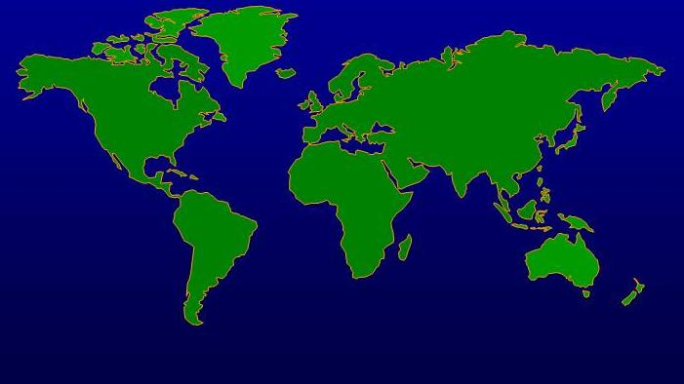
Western
Hemisphere
(New World)
Eastern Hemisphere
(Old World)

Slide 6
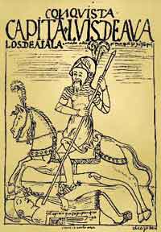
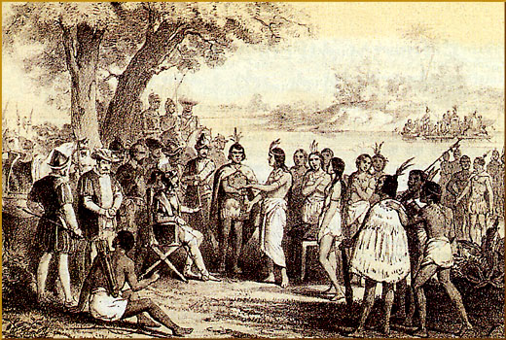
“...all the trees were as different from ours as day from night, and so the fruits, the herbage, the rocks, and all things.”
-- Christopher Columbus
Notes:
The differences between the two hemispheres was often noted by those who were present at the time when Europeans were making their first incursions into the Americas.
* Many Native Americans upon seeing Europeans and their animals for the first time were so shocked at what they saw that they did not know what to make of the invaders. Some thought the Europeans were gods, and when they saw men on horseback they were not sure if they were looking at two animals or one.
* Europeans were equally impressed by the differences. Christopher Columbus wrote that “all the trees were as different from ours as day from night, and so the fruits, the herbage, the rocks, and all things.”
* A Frenchman in Brazil in the 16th century wrote that America is so truly “different from Europe, Asia and Africa in the living habits of its people, the forms of its animals, and, in general, in that which the earth produces, that it can well be called the new world….”

Slide 7
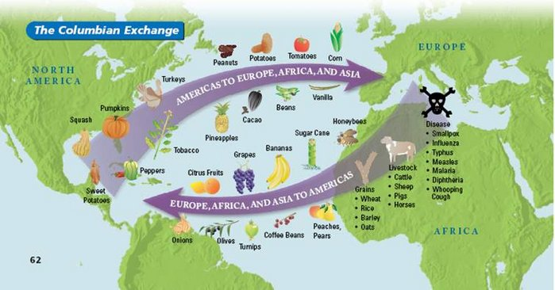
Some interesting facts about the Columbian Exchange
Before the Columbian Exchange there were no:
Oranges in Florida
Bananas in Ecuador
Tomatoes in Italy
Coffee in Colombia
Pineapples in Hawaii
Cattle in Texas
Chili Peppers in India
Cigarettes in France
Chocolate in Switzerland
Potatoes in Ireland

Slide 8
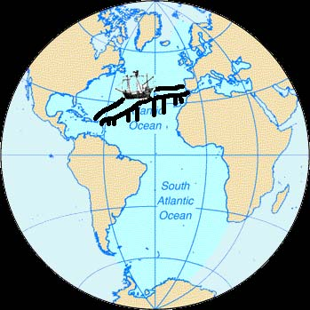
Two biological ecosystems interchanged to create a new world ecology.
Notes:
Two Biological Ecosystems Merge To Create A New World Ecology
When Christopher Columbus brought these two hemispheres (these two very different worlds) in contact with one another by crossing the Atlantic in 1492, he effectively brought together two biological ecosystems which then interchanged over the years to create a new world ecology. The development of this intermixed world ecology had profound consequences for humans.

Slide 9
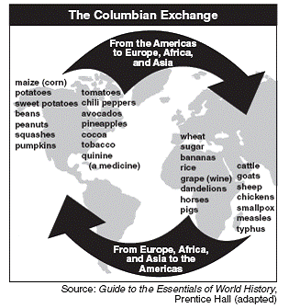
Columbian Exchange
The explorers created contact between Europe & the Americas.
Interaction with Native Americans led to big cultural changes.
Exchange of physical elements: animals, plants, diseases, weapons, etc.
Between Europe, Africa, and the Americas

Slide 10
Animals

Slide 11
Columbian Exchange Animals
Old World (Europe) to New World (Americas)
Animals:
horses
cattle
pigs
sheep
goats
chickens

Slide 12
Columbian Exchange Animals
New World (Americas) to Old World (Europe)
Animals:
llamas
alpacas
guinea pigs

Slide 13
Plants

Slide 14
The Exchange of Plants and Animals
Originally from the Western Hemisphere
Potato
Maize (corn)
Manioc (cassava, tapioca)
Sweet potato
Tomato
Cacao (chocolate)
Squash
Chili peppers
Pumpkin
Papaya
Guava
Tobacco
Avocado
Pineapple
Beans (most varieties, including phaseolus vulgaris)
Peanuts
Certain cottons
Rubber
Turkeys
Originally from the Eastern Hemisphere
Sugar
Olive oil
Various grains (Wheat, rice, rye, barley, oats)
Grapes
Coffee
Various fruit trees (pear, apple, peach, orange, lemon, pomegranate, fig, banana)
Chick peas
Melons
Radishes
A wide variety of weeds and grasses
Cauliflower
Cabbage
Notes:
The New World in return received many new foods from the Old World. In addition to the previously mentioned domesticated animals, the New World received rice, bananas, wheat, rye, barely, sugar and coffee, among other things.
What is your favorite food? (Try to answer where it came from. Would it have been available to you if you were a European or a Native American before 1492?)

Slide 15
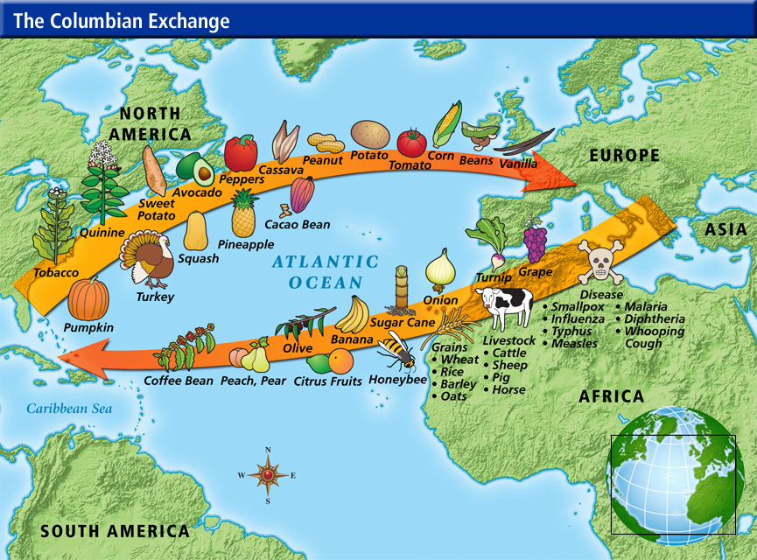

Slide 16
Effects/Impact of Plants and Animals

Slide 17
Impact of the Columbian Exchange of Plants and Animals
Different Foods
Exchange of foods & animals had a dramatic impact on later societies.
Over time, crops native to the Americas became staples in the diets of Europeans.
Potatoes and corn became major food sources for Europeans allowing populations to increase greatly.
Foods provided nutrition, helped people live longer.
Until contact with Americas, Europeans had never tried tomatoes--by 1600s, tomatoes were included in Italian cookbooks.
Economics
Activities like cattle ranching and coffee growing were not possible without Columbian Exchange.
Traditional cuisines changed because of Columbian Exchange.

Slide 18
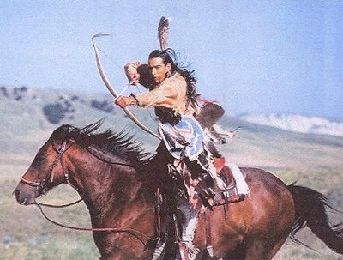
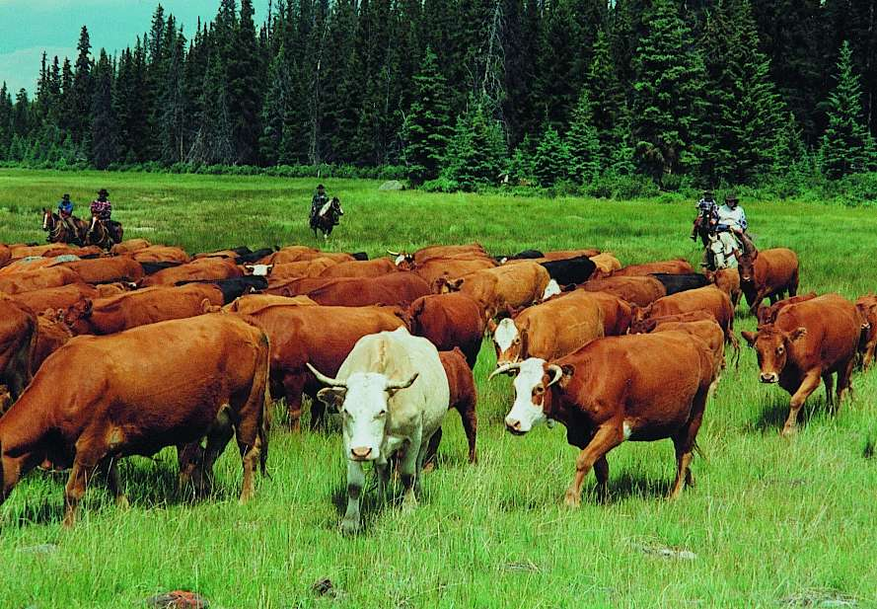
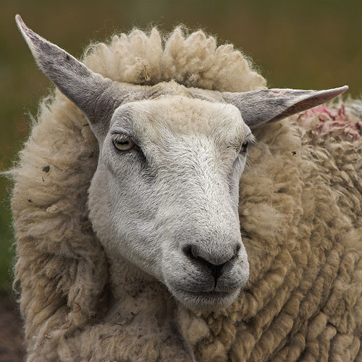
Effects of Animals in New World
Europeans brought over domestic livestock to the Americas
Chickens, cattle, goats, pigs, sheep, horses.
Natives had few domesticated animals, and none weighing more than 100lbs.
The horse revolutionized Native American life, allowing tribes to hunt buffalo far more effectively.
Other animals provided meat, tallow, hides, transportation and hauling.

Slide 19
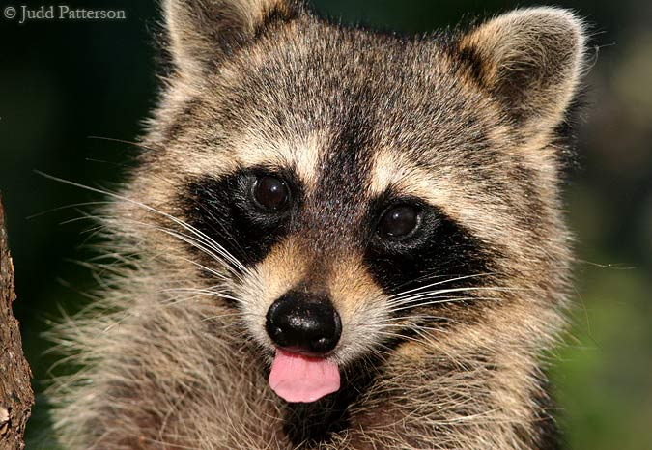
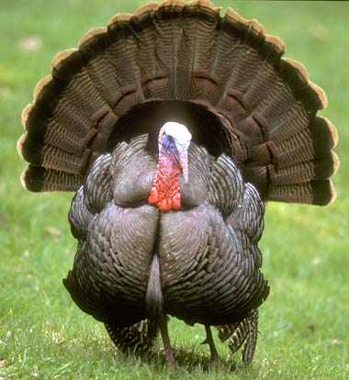
Effects of Animals in Europe
Unlike the huge effect that plants had on other parts of the world, American animals had little effect at all.
One domesticated animal that did have an effect was the turkey.
Raccoons were fancied for their furs.

Slide 20
Effects of Plants and Animals Around the Globe
The Columbian Exchange not only impacted Europe & the Americas, but also…
China:
Arrival of easy-to-grow, nutritious corn helped the population grow tremendously.
Africa:
two native crops of Americas--corn, peanuts--still among most widely grown
Scholars estimate one-third of all food crops grown in the world are of American origin.
Introduction of new crops from the Americas to Europe, Africa, and Asia led to population growth

Slide 21
Diseases

Slide 22
The Introduction of New Diseases
Nearly all of the European diseases were communicable by air & touch.
Smallpox, measles, diphtheria, whooping cough, chicken pox, bubonic plague, scarlet fever and influenza were the most common diseases exchanged.
Illness in Europe was considered to be the consequence of sin.
Indians, who were largely “heathen” or non-Christian were regarded as sinners and therefore subject to illness as a punishment.

Slide 23
Columbian Exchange Diseases
Old World (Europe) to New World (Americas)
Disease:
Measles
Chicken pox
Smallpox
Yellow fever
Malaria
Influenza (flu)
Common cold

Slide 24
Columbian Exchange Diseases
New World (Americas) to Old World (Europe)
Disease
Syphillis
Hepatitis
Polio
Tuberculosis

Slide 25
Effects/Impact of Diseases

Slide 26
Smallpox
Central Mexico - 25 million in 1519 to less than one million in 1605
Hispañola - One million in 1492 to 46,000 in 1512
North America - 90% of Native Americans gone within 100 years of Plymouth landing

Slide 27
Devastating Impact of Diseases
Native Americans had no natural resistance to European diseases .
population continued to decline for centuries
Inca empire decreased from 13 million in 1492 to 2 million in 1600.
North American population fell from 2 million in 1492 to 500,000 in 1900.

Slide 28
Effects of Diseases
Native American population dramatically decreases
Europeans need labor to cultivate new crops in the Americas, but there aren’t many natives left.
Europeans look to Africa & begin to import African slaves to the Americas.
Since African slaves had already developed immunity to European diseases, the colonists began to ship thousands of slaves from Africa to the Americas.
Social order in the Americas consisted of Europeans as the upper class, and Africans, American Indians, and others of mixed race as the lower class.
This social order was based on conquest and racism. Racism is the belief that some people are better than others because of racial traits, such as skin color.
Slave labor continued in the Americas until the 1800s
This led to the slave trade we learned about in the Africa Unit.

Slide 29
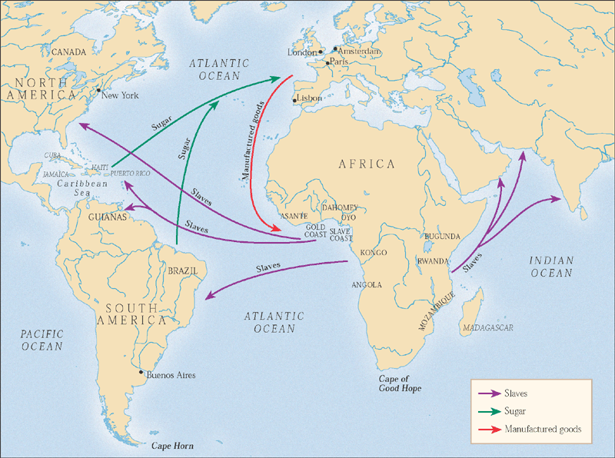
The Atlantic slave trade, 1500-1800.

Slide 30
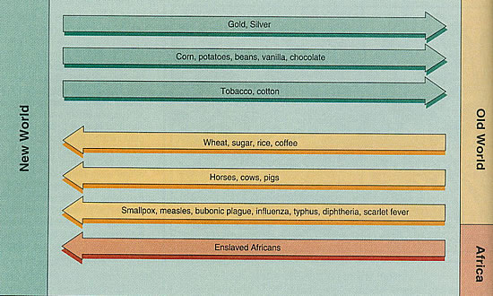

Slide 31
Exchange of Culture

Slide 32
Exchanges of Culture
Two of the biggest cultural changes that the Europeans brought to the New World were religion and language.
Christians set out to convert people in the new lands to their religion.
Missionaries went all over the world. In some places their religion blended with the local religion to create new kinds of religion.
Missionaries also built schools and taught the natives European languages such as Spanish, Portuguese, and Dutch.

Slide 33
Effects of Exchange of Cultures
Spread of European languages
Spread of Christianity
Spread of European culture
Destruction of native religions and cultures

Slide 34
Exchanges of Technology Effects on New World
Europeans took guns and steel to parts of Africa and to the Americas. They also introduced ways to use the wheel in the Americas.
Horses were introduced for riding, as well as for carrying heavy loads. Oxen were introduced for plowing fields.
Animals were used to carry the silver from mines. Sheep created a new industry when people began making textiles.
People began to grow sugarcane on plantations, or large farms.

Slide 35
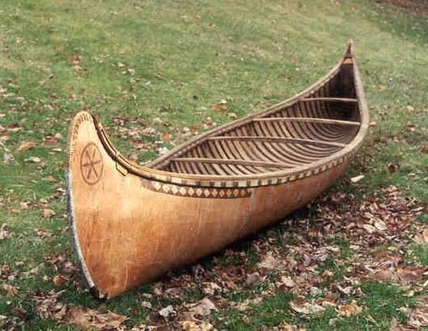
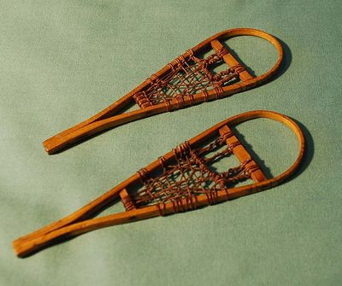
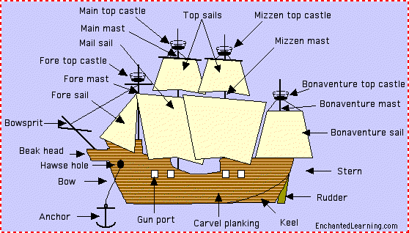
Exchanges of Technology Effects on Europe
Native Americans taught the Europeans local farming methods.
Europeans adopted devices invented by the Natives such as the canoe, the snowshoe, the hammock and the poncho
Europeans introduced the Native Americans to metalworking, new techniques of shipbuilding, and new forms of weapons, including firearms.

Slide 36
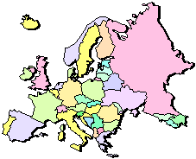
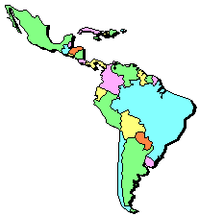
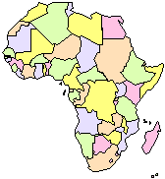
The “Columbian Exchange”
Squash | Avocado | Peppers | Sweet Potatoes
Turkey | Pumpkin | Tobacco | Quinine
Cocoa | Pineapple | Cassava | POTATO
Peanut | TOMATO | Vanilla | MAIZE
 | Syphilis
Trinkets
Liquor
GUNS
Olive | COFFEE BEAN | Banana | Rice
Onion | Turnip | Honeybee | Barley
Grape | Peach | SUGAR CANE | Oats
Citrus Fruits | Pear | Wheat | HORSE
Cattle | Sheep | Pigs | Smallpox
Flu | Typhus | Measles | Malaria
Diptheria | Whooping Cough

Slide 37
Long Term Causes:
God
Gold
Glory
Immediate Causes:
Europeans arrive in the Americas
Europeans bring new plants, animals and diseases to the Americas
Columbian
Exchange
Immediate Effects:
Spanish conquer Aztecs and Incas
Native Americans die of European diseases
Enslaved Africans are brought to the Americas
American foods are introduced to other parts of the world
Long Term Effects:
Spread of products all around the world
Population growth in Europe, Asia, and Africa
Cultural diffusion
Migration from Europe to the Americas
Growth of Capitalism

Slide 38
YouTube Video: Just Click On Next Slide
“The Columbian Exchange”
Keith Hughes
Published on Sep 24, 2016
Running Time of 10:00 Minutes
Explore the effects of Columbus and the Columbian Exchange, which will change the future of both the new and old worlds.
https://www.youtube.com/watch?v=OwyfrJWJE_g

Slide 40
YouTube Video: Just Click On Next Slide
“The Columbian Exchange: Crash Course World History #23”
CrashCourse
Published on Jun 28, 2012
Running Time of 12:08 Minutes
https://www.youtube.com/watch?v=HQPA5oNpfM4
In which John Green teaches you about the changes wrought by contact between the Old World and the New. John does this by exploring the totally awesome history book "The Columbian Exchange" by Alfred Cosby, Jr. After Columbus "discovered" the Americas, European conquerors, traders, and settlers brought all manner of changes to the formerly isolated continents. Disease and invasive plant and animal species remade the New World, usually in negative ways. While native people, plants, and animals were being displaced in the Americas, the rest of the world was benefitting from American imports, especially foods like maize, tomatoes, potatoes, pineapple, blueberries, sweet potatoes, and manioc. Was the Columbian Exchange a net positive? It's debatable. So debate.

Slide 42
YouTube Video: Just Click On Next Slide
https://www.youtube.com/watch?v=1IND9s5uvlI
The Columbian Exchange: National History Day 2016
Itsme_ KaylaB
Published on Feb 7, 2016
Running Time of 9:02 Minutes
Short video documentary over the explorations, encounters and exchanges of the Columbian Cxchange and the events that followed its existence. By: Kayla Braggs Bianca Colang Zenaya Williams Dutchtown High School Hampton, Ga

