Slide 1
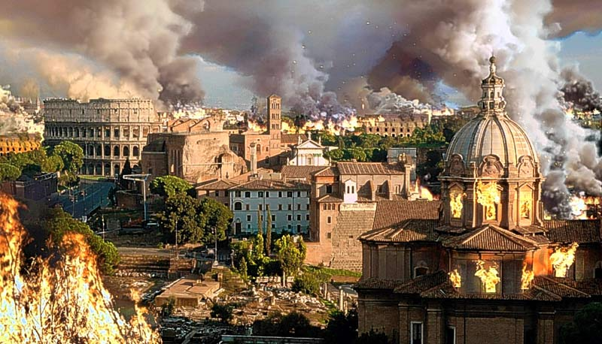
Objective:
To learn about the causes of the fall of the Roman Empire and compare the challenges facing America through political cartoons.
Create a SPECTRUM that range from “The Most Important Reason for Rome’s Fall” to “The Least Important Reason for Rome’s Fall”.

Slide 2
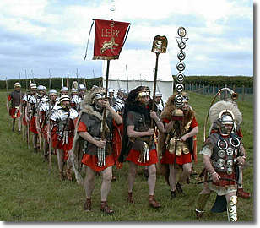
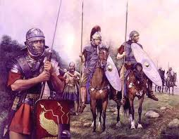

Slide 3
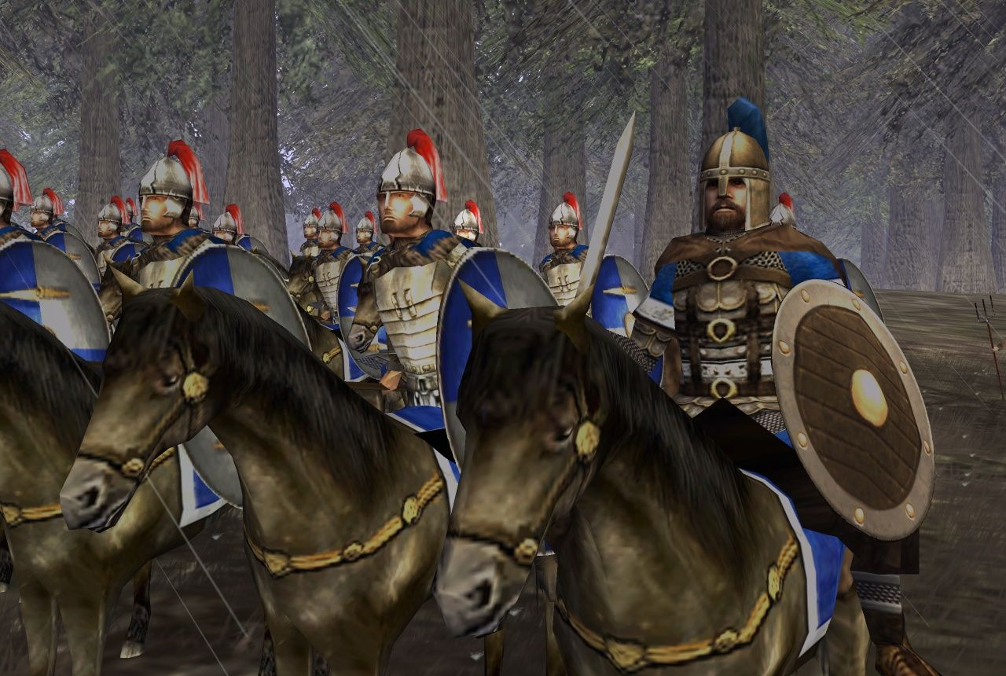
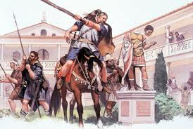

Slide 4
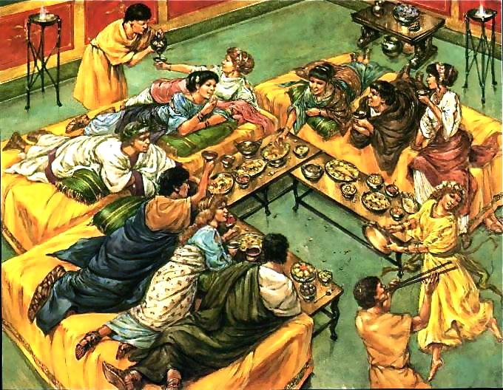
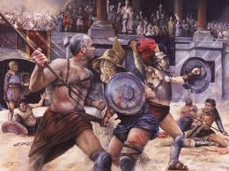

Slide 5
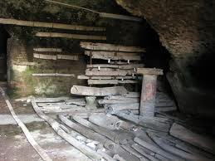
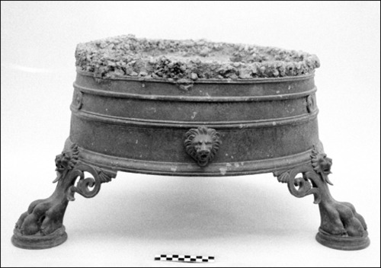

Slide 6
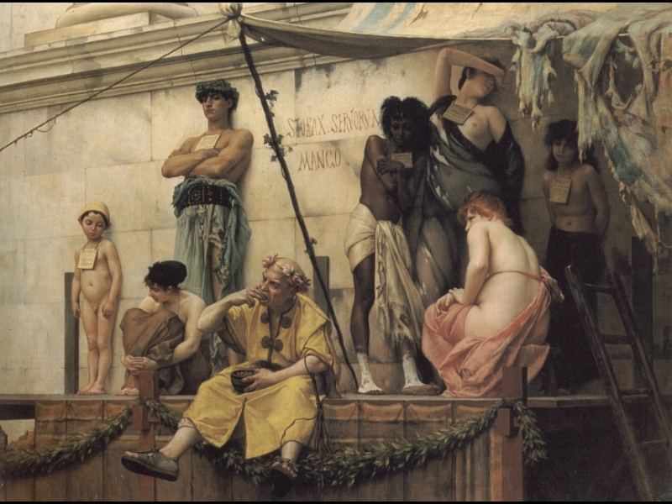
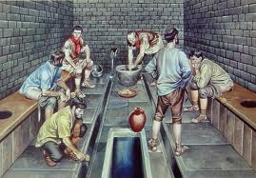

Slide 7
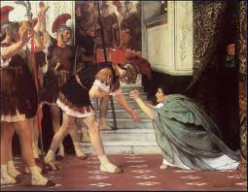
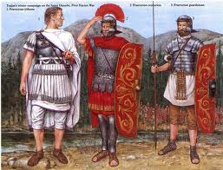

Slide 8
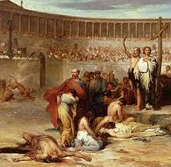
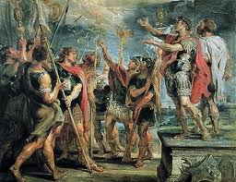

Slide 9
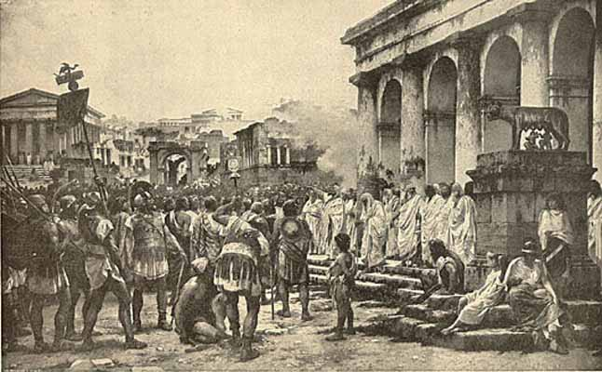
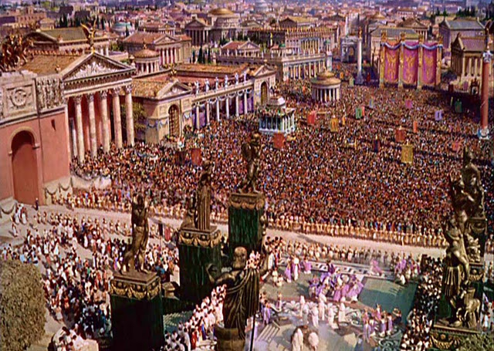

Slide 10
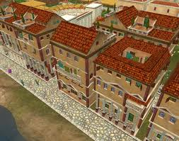
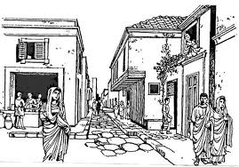

Slide 11
What is happening in this cartoon?
Which theory of the fall of the Roman Empire does this cartoon best relate to?
What are the similarities and differences between Ancient Rome and America today on this issue?
Will there be any money for education?

Slide 12
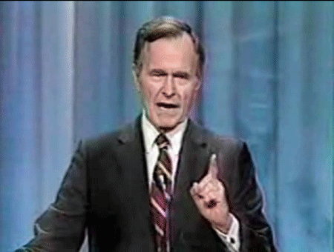
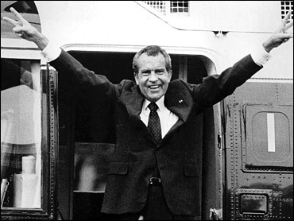
What is happening in this cartoon?
Which theory of the fall of the Roman Empire does this cartoon best relate to?
What are the similarities and differences between Ancient Rome and America today on this issue?

Slide 13
What is happening in this cartoon?
Which theory of the fall of the Roman Empire does this cartoon best relate to?
What are the similarities and differences between Ancient Rome and America today on this issue?

Slide 14
What is happening in this cartoon?
Which theory of the fall of the Roman Empire does this cartoon best relate to?
What are the similarities and differences between Ancient Rome and America today on this issue?
How many slices can you afford this week, ma’am?

Slide 15
What is happening in this cartoon?
Which theory of the fall of the Roman Empire does this cartoon best relate to?
What are the similarities and differences between Ancient Rome and America today on this issue?

Slide 16
What is happening in this cartoon?
Which theory of the fall of the Roman Empire does this cartoon best relate to?
What are the similarities and differences between Ancient Rome and America today on this issue?

Slide 17
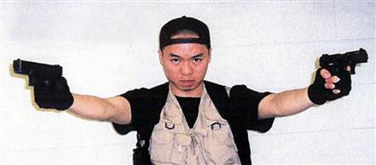
What is happening in this cartoon?
Which theory of the fall of the Roman Empire does this cartoon best relate to?
What are the similarities and differences between Ancient Rome and America today on this issue?

