Slide 1
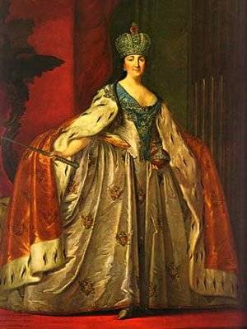
Chapter 18
The Eighteenth Century:
European States, International Wars, and Social Change

Slide 2
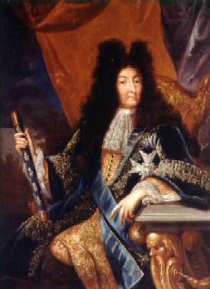
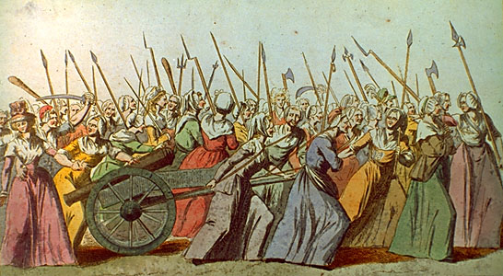
Overall Trends
18th century = 1715-1789 (end of Louis XIV to French Revolution)
This also is the Enlightenment.
Last era of OLD ORDER based on kings, landed aristocracy, agrarian-based existence (3 estate system)
At this era’s conclusion, growing secularism and rationalism leads to outbreak of French Revolution and the establishment of a NEW ORDER in Europe.
Peace out.
Die, Old Order, Die!

Slide 3
Enlightened Absolutism
Generally European states were ruled by a monarch typically determined by dynastic succession and divine right
Aspects of this started to change into 18th century, with “divine right” the first casualty
As ideas of “natural rights,” universal laws and rationalism spread, rulers often had to adjust
Concept of “enlightened despotism” emerged as rulers became more acquainted with work of philosophes

Slide 4
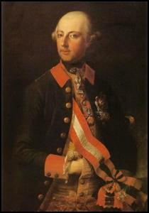
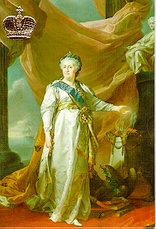
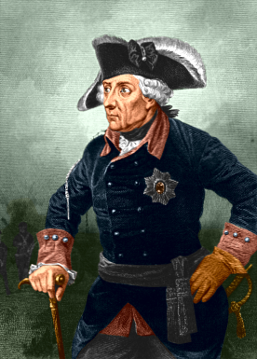
Defining Enlightened Absolutism
Like their predecessors, justified authority by utility
However, certain characteristics set them apart
Secular leadership
Rational and reform-minded policies
Harnessed Enlightenment rationality to state actions to strengthen their own power (acceleration of monarchy)
In the end, many of these rulers scaled down their enlightened ideas when their power was threatened
Also called “Enlightened despotism”

Slide 5
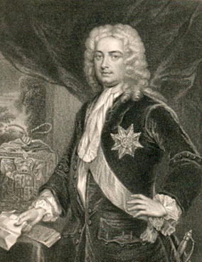
Trends in Western Europe
Robert Walpole: First Prime Minister

Slide 6
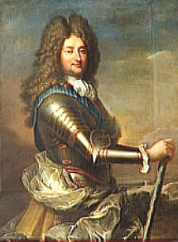
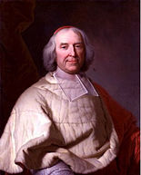
The Failure of Enlightened Despotism: France
France was least successful in adopting “enlightened” policies
Louis XIV left France with quite a legacy
enormous debt
angry populace
his 5-year old great-grandson Louis XV as his successor
Young Louis’ regent, the Philippe II, duke of Orleans ruled France until Louis was 12
The duke was intelligent, but was also plagued by his excessive tastes
Easily manipulated by aristocrats in the old parlements
When he became king, Louis XV was initially helped by his minister, Cardinal Fleury, who avoided war, expanded trade and commerce and even balanced the budget!
Philippe II and Cardinal Fleury

Slide 7
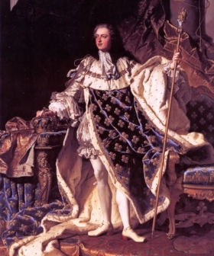
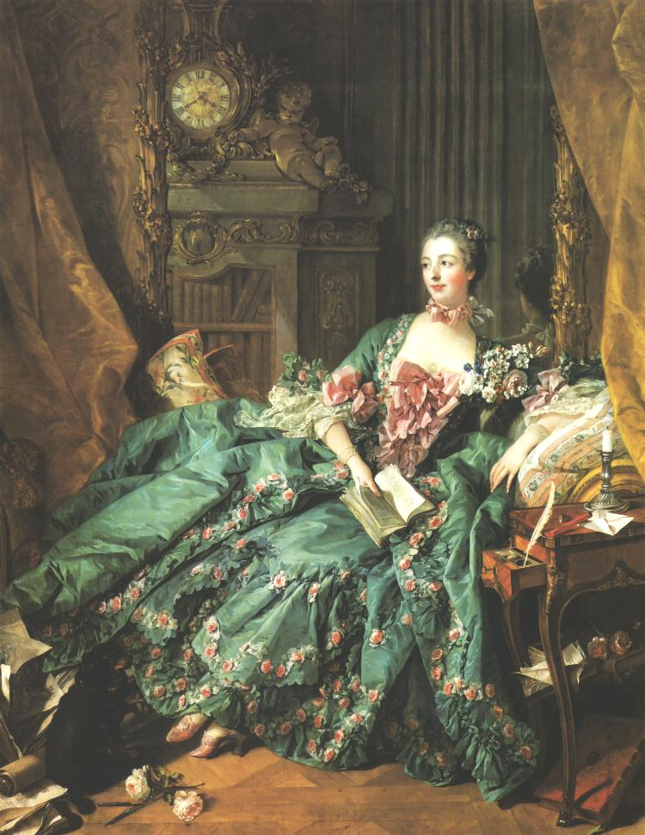
The Failure of Enlightened Despotism: France
I’m WEAK
Louis XV ruled alone after the death of 90 year-old Fleury in 1743
Louis was lazy, weak, and easily manipulated by ministers and mistresses
The most infamous of these mistresses was Madame de Pompadour who was both intelligent and beautiful
Pompadour gained influence over Louis in both the private and the public sphere, giving advice on appointments and foreign policy
I’m HOT

Slide 8
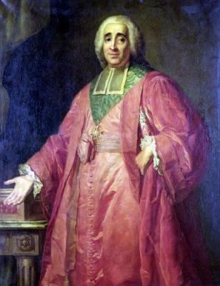
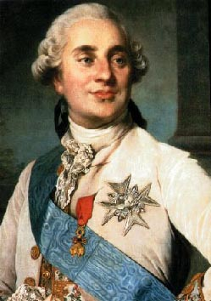
The Failure of Enlightened Despotism: France
Louis’ government was undermined by its methods of raising revenue
Crown earned money by selling offices and privileges
More people purchased these privileges so fewer could be taxed!
7 Years’ War increased demand for funds - crown tried to tax nobility and exempt bourgeoisie, but local parlements blocked this
Maupeou, as chancellor, dissolves old parlements and replaces them with those loyal to the crown
Louis XV dies and Louis XVI reinstates the old parlements, appeasing the privileged class…
Maupeau and Louis XVI

Slide 9
Great Britain: King and Parliament
Act of Union 1707: England became Great Britain when governments of England and Scotland merged to fight War of Spanish Succession (Scots got MPs and retained Presbyterianism)
King and Parliament shared power
King appointed ministers
Parliament made laws, levied taxes, passed the budget and indirectly influenced the king
Members of Houses of Lords and Commons were privileged classes who often intermarried
Corrupt “elections”
Patronage System
“Pocket boroughs”/“rotten boroughs” (until Reform Act of 1832!)
Privileged “bought” representation; no secret ballot elections
Undemocratic representation based on tiny electorate
Nearly half the members of Parliament won their seats this way in 1761

Slide 10
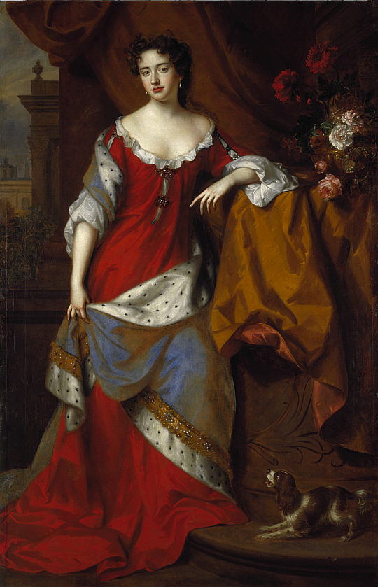
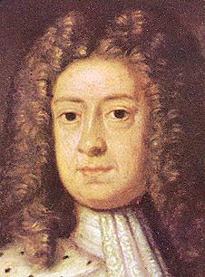
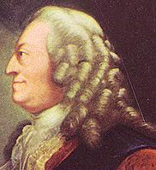
Great Britain: King and Parliament
1714, last reigning Stuart monarch, Queen Anne dies
Parliament’s Act of Settlement of 1701 secured succession of a Protestant, not the other Catholic Stuarts
German House of Hanover, came to rule England in personage of George I
George I (1714-1727) didn’t even speak English!
Increased power of his ministers
Successor George II (1727-1760) didn’t understand the English government either
Increased role of cabinet system in British government
Civil War?
German king repulsive to some, who also feared the growing power of the businessmen and London merchants in Parliament
Sought to reestablish the Stuarts under James II’s son James III (Jacobites)
“The Pretender” launched an unsuccessful rebellion from Scotland (1715) with help of Highlanders
His son, Bonnie Prince Charlie tried in 1745, ultimately failing and provoking a serious smack-down in Scotland at Culloden (1746), solidifying Parliament’s hold on British government under George II and very harsh treatment for the Scottish Highlanders.
I must say, George…Anne made a much hotter monarch
Ya.
Anne and the “Large Germans”
Notes:
While Bonnie Prince Charlie captured Edinburgh successfully, he was stopped at Culloden. After Young Pretender put down, many executions of Scots by English. Highlanders disarmed and forbidden from wearing kilt and tartan

Slide 11
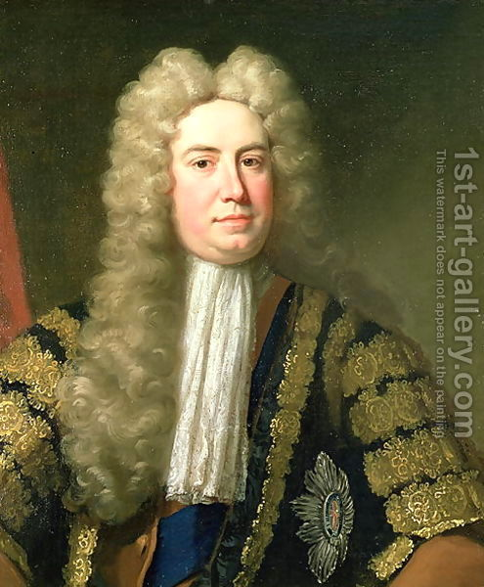
Great Britain: Walpole
Robert Walpole - first Prime Minister (1721-1747) taking over after a financial investment scandal
England’s parliamentary government was able to levy taxes effectively, so they recovered far better than France
Walpole: quieta non movere (“let sleeping dogs lie”)
Avoided unpopular issues
Chose cabinet members loyal to majority and to him
Avoided more taxes by avoiding war - at least until 1739
War of Jenkins’s Ear (1739-42) morphed into a full-scale set of world-wide conflicts involving all of Europe collectively known as the War of Austrian Succession and the Seven Years’ War.
Conflicts were about 2 issues: French-British rivalry for trade, colonies and sea power AND Prussian-Austrian rivalry for territory and military power
Walpole: First PM – and keeper of luscious, salon locks.

Slide 12
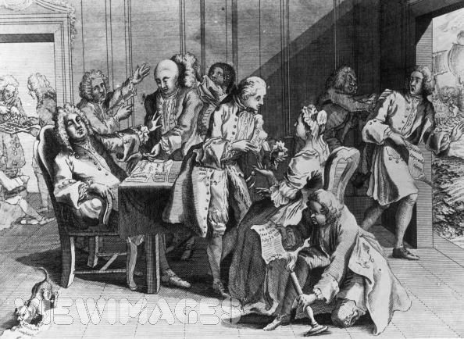
Jenkins’s Ear (?)
‘Ear it is!
I’m
gonna
hurl.
OH! PUT THAT BLASTED EAR AWAY!!
Captain Robert Jenkins displays his severed ear to members of the House of Commons. The Spanish allegedly removed it after capturing Jenkins’ ship violating provisions of the Treaty of Utrecht.

Slide 13
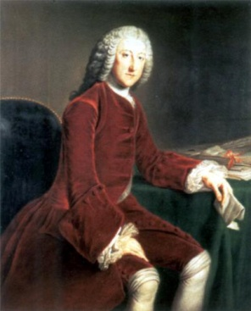
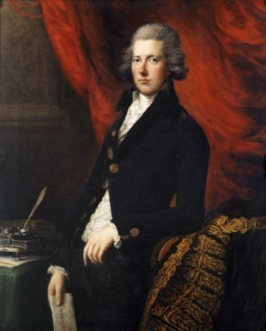
Great Britain: The Pitts
Growing merchant-business class wanted to pursue the wars for empire, as they would benefit directly
Changing tide brought in a new prime minister, William Pitt the Elder in 1757
Under Pitt the Elder, British acquired Canada and India in Seven Years’ War
George III, however, dismissed him in favor of Lord Bute in 1761
Loss of American colonies and George’s increasing power over parliament forced George to eventually make concessions
Appointed William Pitt the Younger in 1783, who was popular with both the merchants and the growing industrial classes
George III, however, descended into madness
Parliamentary system, corrupted by interests of privileged classes, failed to be reformed
The Pitts: Elder, Younger, and Arm

Slide 14
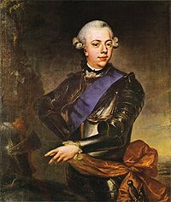
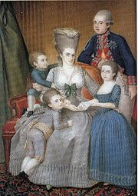
Decline of the Dutch
On decline
Orangists vs. regional oligarchs began the civil conflict
Oligarchs (“Regents”) rebelled (1780) against Orangist stadholder William V to get more democratic power
Then, merchant-artisan-shopkeepers broke away from the oligarchs to form Patriots to increase democratic reforms and were somewhat successful
Prussia interfered and crushed this group because King Frederick William II was the brother of William V’s wife, Wilhemina
Showed that power on the continent had shifted away from the Dutch toward the Prussians
Willie V, Wilhemina of Prussia and fam

Slide 15
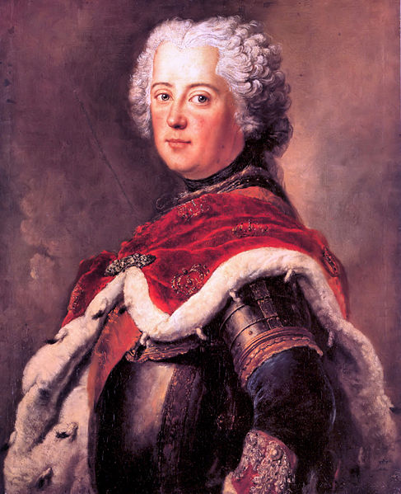
Absolutism in Central and Eastern Europe
Frederick II

Slide 16
Absolutism in Central and Eastern Europe
Of the 5 major European states, 3 were located in Eastern and Central Europe
Prussia
Russia
Austria
These states came to play an increasing role in European international politics
See map on following slide…

Slide 17
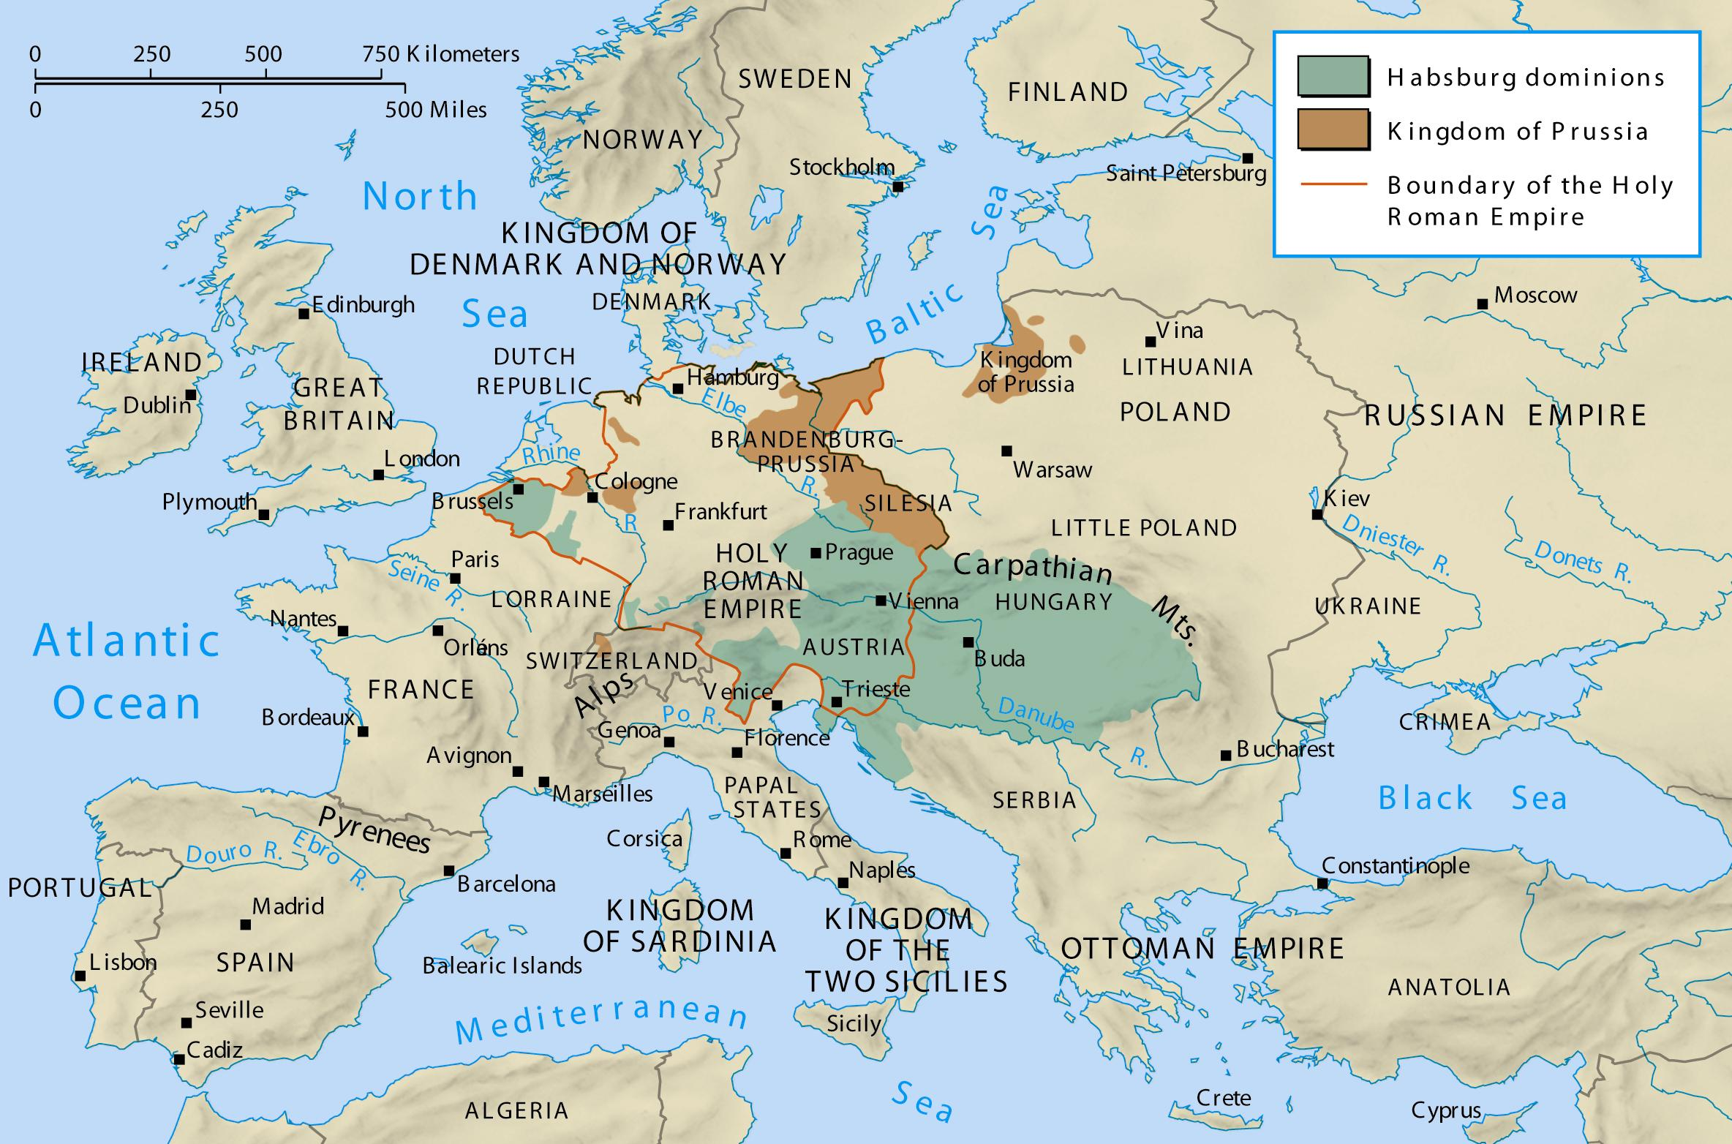
Europe in 1763

Slide 18
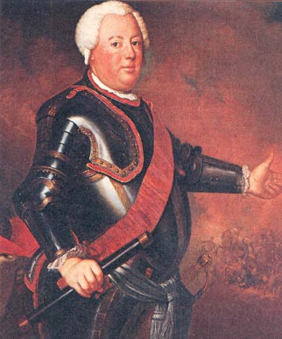
Prussia: Frederick William I (1713-1740) “The Soldier King”
Key to Prussian success: bureaucracy and military
Frederick William developed highly efficient bureaucracy of civil service workers called the General Directory
Supervised military, police, economic and financial affairs
It had its own code, embracing the values of obedience, honor, and service to the king
Frederick William kept close watch over his officials
Rigid class system persisted: Junkers led military
Military grew drastically under F.W.
Using nobles as officers bound them to the king
Prussia - an army with a country
Remaining classes were much less important
Peasants were confined to lords’ estates or army – had few rights
Middle class empowered through civil service
Compulsory Primary Education (1717)
Frederick William tore what he considered "extravagant finery" off the clothes of females in the street and he used to discipline idle building workers in person. It is said that he once gave chase in the street to an escaping pickpocket. Having caught him, the King asked why he had tried to run away. When the man replied that he was afraid of him, Frederick William hit him with his stick and roared: "Miserable wretch! You shall love me!"
Notes:
FW fired his servants and the royal fam helped themselves to their meals of meat and beer.
He was always faithful to his wife
He beat pretty much everyone – except his wife
He hated his

Slide 19
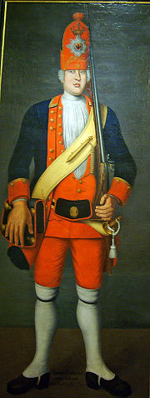
Prussia: Frederick William I (1713-1740) “The Soldier King”
Built up military
Soldiers recruited from peasantry and foreign lands
He recruited and even kidnapped large men to fill ranks of his beloved regiment of Potsdam Giants)
Dissolved lavish court and lived frugally
Royal family helped themselves to meats and beer – no servants!
The queen had to do the dishes!
He encouraged farming, reclaimed marshes, stored grain in good times and sold it in bad times
Despising non-military people and things - particularly Frenchmen, musicians, scientists and intellectuals - Frederick William would never tire of teasing and even physically torturing the president of the Academy of Science
He was never unfaithful to his wife and said there were "no such things as mistresses", only "harlots and whores.“
He was most likely bipolar, having sleepless bouts (mania) as well as crying fits (depression).
On the day of his death, he had himself wheeled into the queen’s bedchamber and announced, "Get up! I am going to die today."
One of the Potsdam Giants

Slide 20
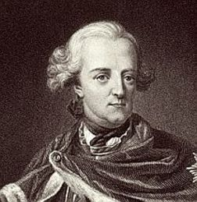
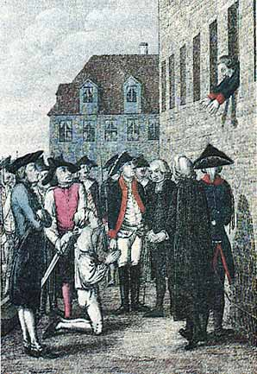
Prussia: Frederick II - The Great (1740-1786)
One of the best educated and most cultured monarchs of the 18th century
Difficult childhood and strained relationship with his father
Forced to awaken each morning to the firing of a cannon
Beaten for wearing gloves in cold weather
At 18, he was kicked, beaten, dragged along the ground by his hair and sent off by FW, bleeding and disheveled, to make an official appearance at the Polish court – he ran away instead
He was caught fleeing with his friend (lover?) Hans Hermann von Katte and was forced to personally witness von Katte’s execution
FW so despised young Fritz’s interest in the arts that he had a girl with whom Fritz had played a flute duet publically flogged
Hans Hermann!!!

Slide 21
Prussia: Frederick II (1740-1786) The Great
He became king at age 28, and deemed himself “first servant of the state”
Initially, followed beliefs of the philosophes
Established a single code of laws
Eliminated use of torture except in treason and murder
Granted limited freedom of speech and press
Granted complete religious toleration
However, he reversed his father’s policy of upward mobility through civil service, reserving high posts for nobles
He also refused to free serfs as he depended on Junkers

Slide 22
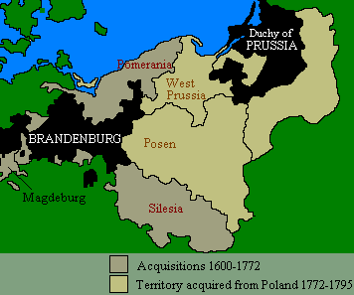
Prussia: Frederick II’s Militarism
Took a great interest in the military
Army grew to 200k men
Unlike his predecessors, he USED his military
Took advantage of succession crisis in Austria and snatched Silesia from Maria Theresa the Hapsburg monarch
This violated the Pragmatic Sanction and the issue was force vs. law – Fred into EXPANSION!
Frederick embroiled in 2 wars: The War of Austrian Succession and the Seven Year’ War
permanent control of Silesia
partitioning of Poland, unifying the Prussian regions
After Frederick II, Prussia had clearly established itself as a major European powerhouse
Under Fred II, Prussia attained Silesia, Posen and West Prussia, uniting Hohenzollern lands

Slide 23
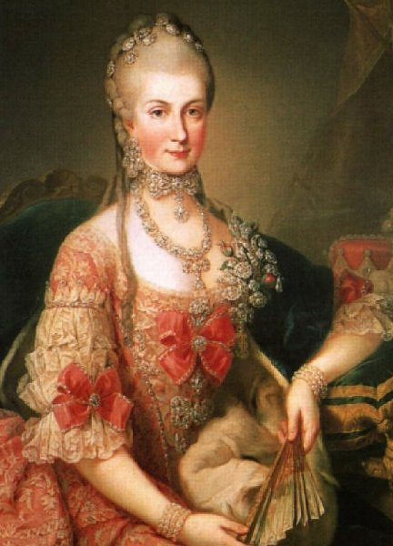
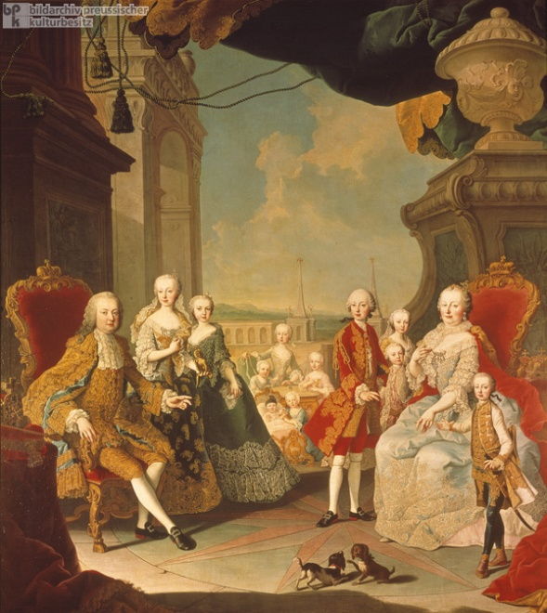
The Hapsburgs’ Austrian Empire: Maria Theresa
By the early 18th century, Austria was a formidable European power
Vienna was the center of the monarchy and music
Austria was home to many ethnicities, languages, religions, and cultures, but could not provide common laws and a centralized administration
Maria Theresa (1740-1780) began her reign tragically, but…
She prepared to go to war by curbing the power of local assemblies
Forced nobles and clergy to pay property taxes directly to royal officials, not local
Divided Austrian lands into 10 provinces administered directly by a royal official.
Expanded army - needed to after Silesia incident!
She was a devout Catholic, and a conservative - not a reformer
She did prove to be one of the strongest Hapsburg rulers

Slide 24
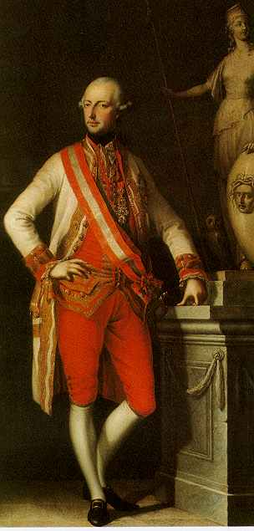
The Hapsburgs’ Austrian Empire: Joseph II
Maria Theresa didn’t care for the philosophes’ ideas, but her son, Joseph II did
Joseph II (WITH MT,1765-1780; alone 1780-1790)
He was interested in Enlightenment ideas
Stated that the state meant “the greatest good for the greatest number”
Abolished serfdom
Established new penal code - no more death penalty and all equal before the law
Freedom of press
Complete religious toleration and restricted the Catholic Church (Edict of Idle)
Tried to impose German language for whole empire and alienated the non-German speaking nationalities - esp. Magyars
After his death, Leopold and others undid his “enlightened” reforms.

Slide 25
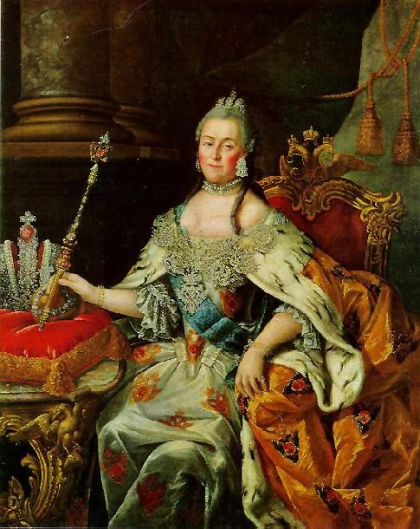
Russia: Setting the Stage for Catherine’s Ascent
The Russian court and aristocracy adopted French as their conversational language, so French Enlightenment ideas did influence Russia.
After Peter the Great, Russian military power expanded, and Russia joined against Prussia in the Seven Years War.
Peter the Great had 6 successors, all of whom were at the mercy of the palace guard.
When the last them, Peter III, was murdered by them, his wife, German Princess Catherine took charge.
Catherine, a Romanov by marriage, ruled from 1762 to 1796 and was the first powerful ruler post-Peter
She was resourceful and court savvy, developing support in high places to engineer the murder

Slide 26
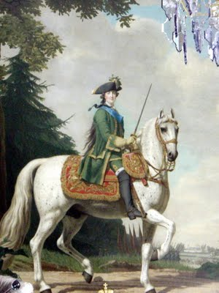
Russia: Catherine’s Policies
Though German, Catherine quickly learned Russian and became Russian Orthodox after her marriage.
She was practical, hearty, and boisterous--a worthy successor for Peter.
She was intellectual, reading Blackstone (law) and corresponding with Voltaire and Diderot.
She publicized her intention to make reforms, and worked to codify the laws, restricting torture, and increasing religious toleration.
Instruction, 1767
She also began to consolidate the machinery of state.

Slide 27
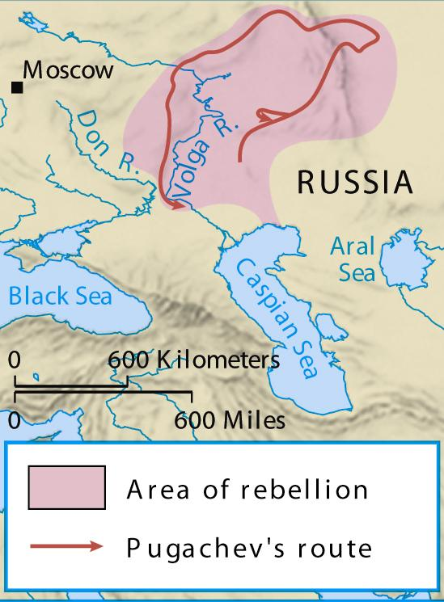
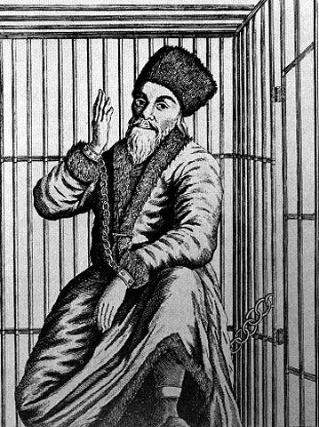
Russia: Catherine and Pugachev
Any idea of reforming serfdom was ended by Pugachev’s rebellion (1773).
Traditional Russians felt oppressed and alienated by aristocracy.
Pugachev, a Cossack, began an insurrection--joined by Cossacks and the serfs of the Ural and Volga regions.
Moscow aristocrats were terrified, but the rebels were stopped
Pugachev was betrayed and captured.
Catherine’s answer was repression, increasing the power of landlords.
As in Prussia, the state came more than ever to rest on an understanding between ruler and gentry.
The gentry accepted the monarchy, with its laws, officials, army and foreign policy, and received in return full authority over the peasants.

Slide 28
Russia: Catherine’s Expansionist Policies
Catherine’s main goal was to secure the loosely organized domains from the Baltic to the Black Sea and the Mediterranean, the land of the Poles and Turks: WARM WATER PORTS!
She defeated the Turks, but was prevented from reaching her territorial goals by “balance of power politics,” receiving instead a portion of Poland in the first partition.
Russia did get the important port of Odessa
The French Revolution gave her the opportunity to finish the partitions of Poland
Many “enlightened” thinkers praised Russia for eliminating Poland--a nuisance, a cause of rivalry.
The partitions changed the balance of power as a whole, making eastern Europe more important.

Slide 29
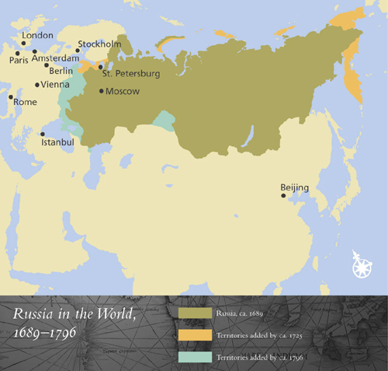
Beginning of Peter’s Reign
End of Peter’s Reign
End of Catherine’s Reign

Slide 30
Limitations of Enlightened Despotism
Catherine to Diderot on reform: ‘You write only on paper, but I have to write on human skin, which is incomparably more irritable and ticklish.’” What does this mean?
Joseph II, Fred II and Catherine the Great were “enlightened despots,” BUT only Joseph II sought radical Enlightenment changes.
In the end, all three were limited by political-social restraints, and people simply weren’t ready for equal rights for ALL…
Enlightened Despotism, in retrospect, foreshadowed an age of revolution and even signified a preliminary effort to revolutionize society by authoritative action from above.
The state became more powerful, and told people that special privileges were bad.
Old and established rights were brought into question
Customary and common law was pushed aside by authoritative legal codes.
By opposing the special powers of the church and feudal interests, the state was moving toward legal equality.

Slide 31
Limitations of Enlightened Despotism
Yet even before the French Revolution, enlightened despotism had reached as far as it could go.
Almost everywhere the result was an aristocratic, even feudal revival, and kings were again renewing ties with the Church.
Enlightened despotism was the culmination of the institution of monarchy.
Groups who did not benefit from reforms – or who lost rights after they demanded more reforms – were increasingly disgruntled…

Slide 32
Declining Powers in Europe
Poland was divided by Russia, Prussia and Austria b/c it had no strong monarch to hold it together.
Mediterranean
Spain on the decline
Austria takes over much of formerly Spanish territory.
Attempts to curtail church and inquisition and French system brought by Bourbon rulers who replaced Hapsburgs there helped, but Spain failed to keep up with more modernized powers.
Portugal was the same
on decline from 16th century heyday
Brief resurgence under Marquis de Pombal, but nobody could replicate his leadership after
Italy fragmented and divided up by larger stronger powers; Savoy emerges as a temporarily powerful Italian state, but it doesn’t last.
Scandinavian States – Sweden and Denmark attempted to establish strong enlightened monarchies, but ultimately failed to completely subdue aristocracy.

Slide 33
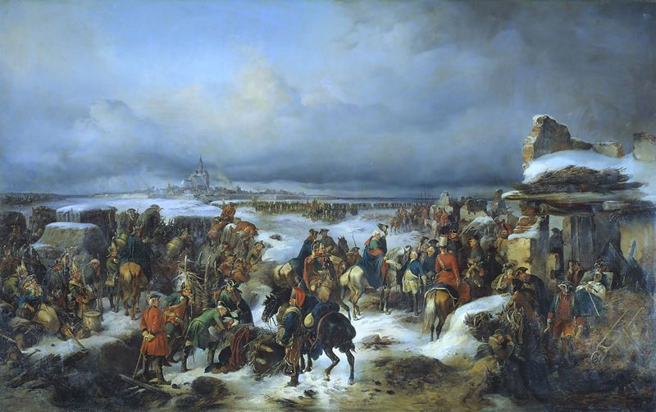
Wars and Diplomacy

Slide 34
Wars and Diplomacy
Although the philosophes condemned war, enlightened depots and the rest of Europe’s political leaders seemed to disregard this.
Rulers acted out of self interest, but because international relations were important in maintaining power, the concept of balance of power was of primary concern.
Use of diplomacy
Concept of reason of state
As new powerful states emerged and jockeyed for territory, colonies and markets, their large standing armies eventually were put to use
Relative peace form 1715 to 1740 gave way to the first of a series of 18th century conflicts due to the succession to the Austrian throne

Slide 35
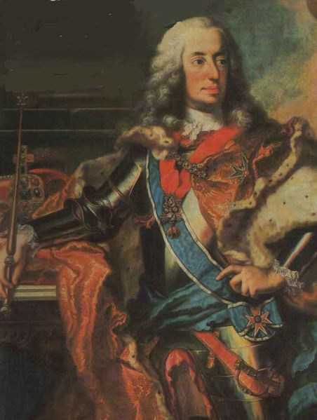
War of Austrian Succession (1740-1748)
Austrian Hapsburg Emperor Charles VI - no male heir
Pragmatic Sanction
All agreed while Charles lived; upon his death the agreement was pushed aside
Fred the Great takes Silesia
In the south, the ruler of South German Bavaria seized Hapsburg territory and had himself elected as the new HRE Charles VII in 1742 (his 3 year tenure as HRE marked a break in Hapsburg rule)
Charles VII of the House of Wittelsbach: a break in Hapsburg hegemony

Slide 36
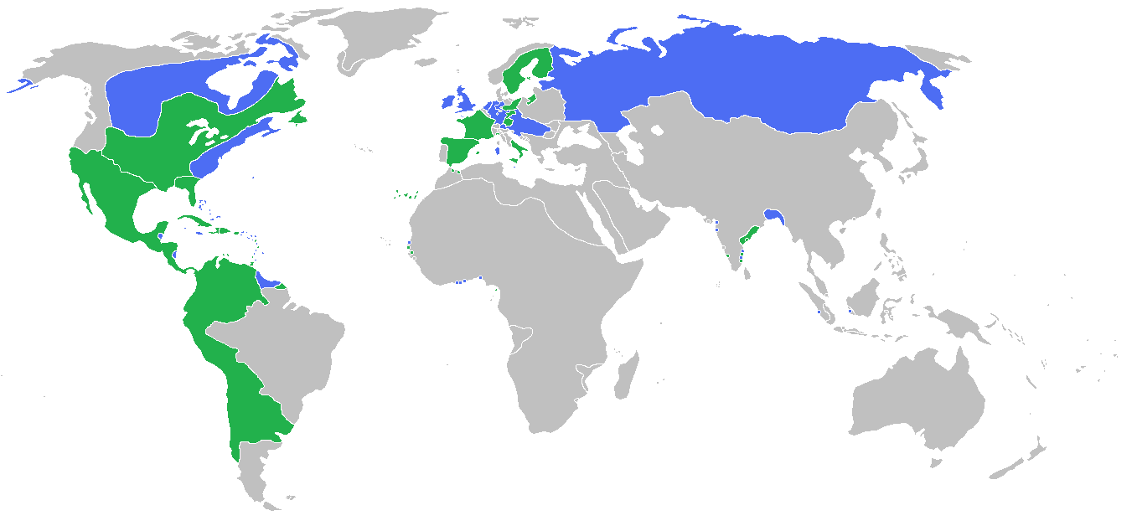
War of Austrian Succession (1740-1748)
France enters into the war vs. vulnerable Austria to see what it could snatch up.
Austria finds an ally with Great Britain, who feared that France would dominate continental affairs.
Unfortunately, these powers had established a presence OUTSIDE Europe, and these regions went to war as well
France - GB in India
France - GB in North America
Meanwhile in Europe, Prussia dug into Silesia and France took the Austrian Netherlands.
By 1748, with no end in sight, all parties agreed to stop and by the Treaty of Aix la Chapelle, all occupied territories were returned - except Silesia…fighting would go on later…

Slide 37
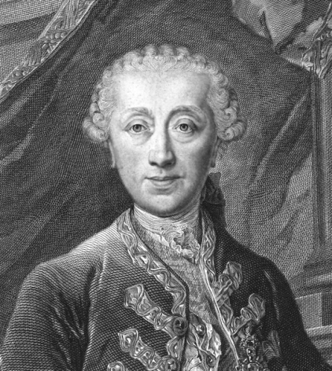
Seven Years’ War (1756-1763): Diplomatic Revolution
Maria Theresa refused to accept loss of Silesia and prepared for another conflict by building up her army and forming important diplomatic ties
Count Wenzel von Kaunitz
Separate Prussia from its chief ally, France
Long history of Hapsburg-Bourbon rivalry to undo…
“diplomatic revolution” of 1756: the impossible happens!
Old rivalries became superfluous as new ones developed:
France vs. GB for empire
Austria vs. Prussia for Silesia
Russia vs. Prussia for territory in central Europe
Count Wenzel von Kaunitz

Slide 38
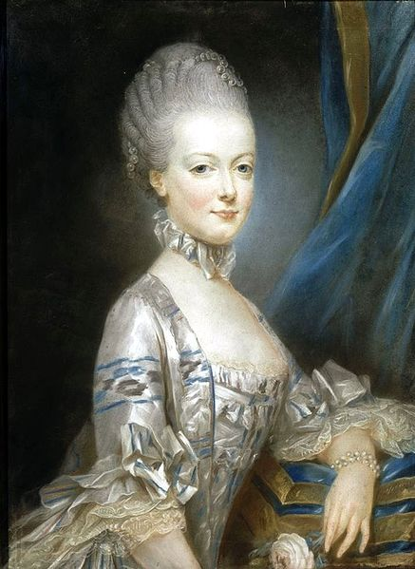
Seven Years’ War (1756-1763): Diplomatic Revolution
Westminster Convention (January, 1756)
GB and Prussia meet to foil British-Austrian alliance
Prussia will protect Hanover from France if GB abandons Austria
Meanwhile, von Kaunitz sent by Maria Theresa to engineer alliance with Louis XV of France
Louis agrees to defensive alliance after hearing of Westminster settlement
Also, marriage of Marie Antoinette to his son Louis XVI seals deal
Marie Antoinette, age 13, in the portrait that was sent to the dauphin Louis before their marriage

Slide 39
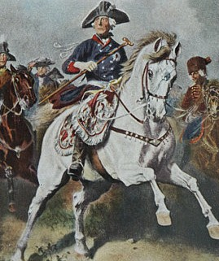
Seven Years’ War (1756-1763)
New Alliances:
Russia, Austria, France
Prussia, Britain
A military clash between these two alliances meant WORLD-WIDE conflict – Europe, India and North America all saw battles fought on their soil.
Battle of Rossbach in Saxony (1757) – Fred II victorious
Eventually, Combined Austrian, French and Russian forces wore the Prussians down
Frederick II in the Seven Years’ War

Slide 40
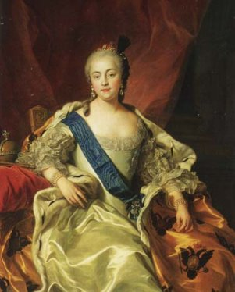
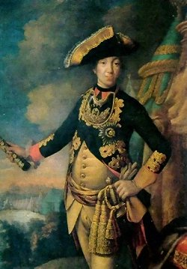
Seven Years’ War (1756-1763)
Prussian “Miracle:” Empress Elizabeth of Russia dies
Tsar Peter III withdraws Russian forces and returns Prussian territories
This leads to stalemate and desire for peace
Peace of Hubertusburg (1763)
All European territories returned EXCEPT SILESIA!
MT legally gains control of so-called Holy Roman Empire with the election of her husband as Emperor Francis I (and their 16 kids!)
Outside Europe…
Great War for Empire (India) GB wins control by Treaty of Paris (1763)
French and Indian War (N.A.) GB wins control of Canada and land east of Mississippi by Treaty of Paris.
Elizabeth and Peter III

Slide 41
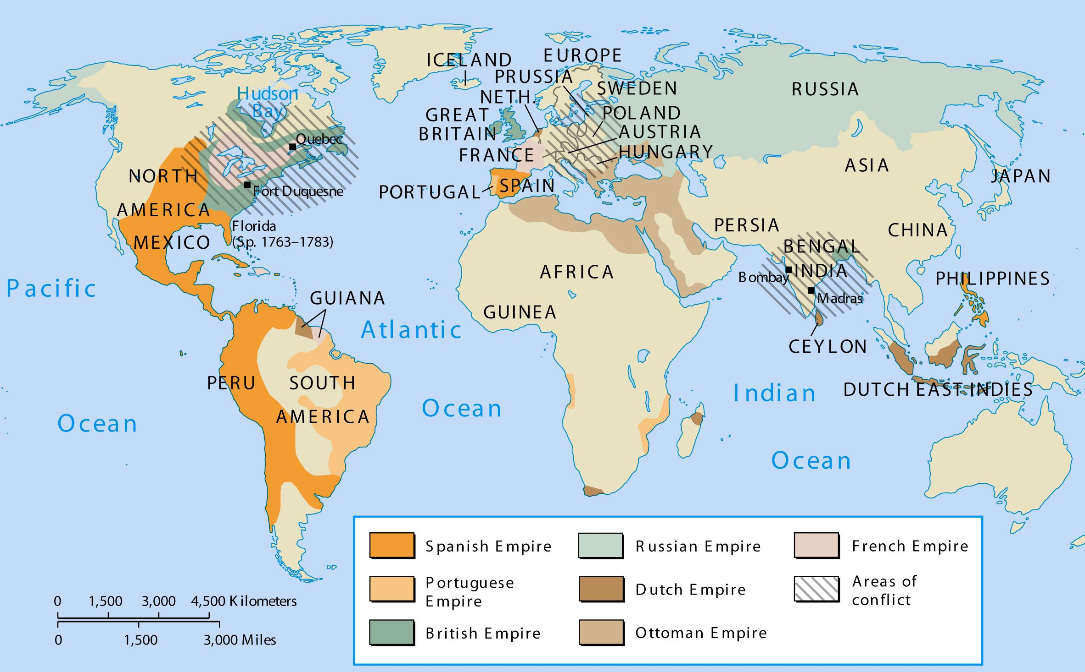
The Battlefields of the Seven Years’ War
©2003 Wadsworth, a division of Thomson Learning, Inc. Thomson Learning™ is a trademark used herein under license.

Slide 42
Changing Nature of Armies
Professional standing armies, novel in the 17th century, were a mainstay by the 18th
Most armies doubled or tripled between 1470-1780
Structure reflected social hierarchy – landed aristocrats were top-ranking officers (in Prussia, Junkers served mandatory terms); Middle class achieved mid-rank and commoners could not be officers
Many states relied on conscription of unemployed artisans and peasant class, but they needed the agricultural laborers, so they turned to mercenaries as well.
GB used more mercenaries than any other power
GB and Dutch found navy to be more important and invested their efforts there
War no longer fought over ideological issues like religion – now it was fought with realistic concerns – costs in taxes, lives, resources
This changed the nature of fighting – trickery more than direct confrontation
Construction of vast fortresses for supplies – defeat came down to surrendering these strongholds

Slide 43
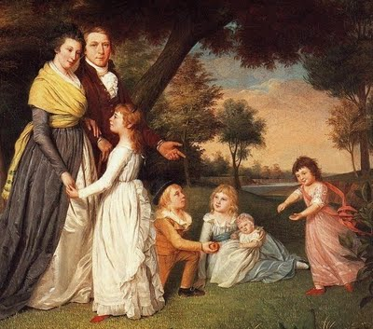
Economic and Social Trends

Slide 44
Population Growth
By 1750, population began a steady climb upward – a shift from the fluctuating tendencies seen since the Middle Ages
One main reason: decline in infant mortality
Trend NOT explained by healthcare improvements, but rather a more ample food supply and the end of plague outbreaks (last outbreak: 1720)

Slide 45
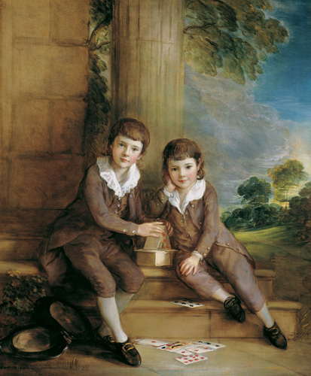
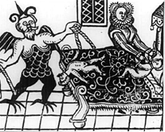
Marriage and Family: Children
Use of wet nurses by middle and upper classes in early 18th century
breast feeding was deemed “undignified”
NO SEX while breastfeeding!
By later 18th century, attitudes toward children changed
Children no longer seen as mini-adults
Toys, comfortable clothing, love, breast feeding, end of primogeniture
Infanticide and “suffocating accidents”
Foundling homes 50-90% mortality rates

Slide 46
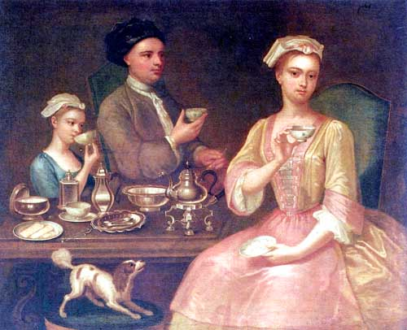
Marriage and Family: Marriage
Family still at heart of social organization
Still patriarchal
FOR UPPER CLASSES, marriage for position
Newlyweds established own households – later marriage ages (27-8 men, 25-7 women)
Birthrate Patterns
Illegitimacy rates up
4-5 children per family typical
Birth control? Coitus interruptus
Children as part of family economy for lower classes
Above: Coitus interruptus.
Below: NO coitus interruptus.

Slide 47
The Social Order
Old estate system persisted into the 18th century
Reinforced by Christianity (hierarchy)
Perpetuated by most law codes (marriage laws?)
Culture necessitated it (clothing?)
Changes of the Enlightenment era slowly crept in, but the system was not really shaken until the French Revolution

Slide 48
The Social Order – The Peasants
Peasants comprised roughly 85% of the population
Some were free, others were serf bound to land
Free serfs faced difficulties
Owned little or no land
Tithes took crops
Local aristocrats restricted hunting rights, access to flour mills, wine presses and oil presses
Serfs in eastern Europe were subject to the whims of the lord

Slide 49
The Social Order – The Nobility
Nobility comprised about 2-3% of society
Often ruled over peasants/serfs
Many exempt from taxes or severe punishments
Allowed to carry sword
Often held highest military offices and/or controlled local governments
Some were very rich while others had little money
Those who did not have wealth found existence increasingly difficult
Titles alone were less likely to maintain privilege

Slide 50
The Social Order – The Nobility
Wealthiest had a house in the city and a country estate
Rooms for different activities (drawing room, dining room, study)
Servants’ quarters
Grand Tour – staple for aristocratic young men’s educational experience

Slide 51
The Social Order – General Trends
Most people still lived in rural areas, but towns and cities were rapidly growing
Enclosure Acts forced many into urban areas to seek work
Overcrowding in urban areas without proper urban planning created unsanitary conditions
Disease
Crime
Prostitutes & Beggars – 30% of population!
Belief in “Christian Duty” to help poor faded
Some enlightened thinkers turned to the state
Most regarded the poor with disdain and disgust
At close of 18th century, change was brewing, and major upheaval was just around the corner…

Slide 52
Agricultural Revolution?
Was there a revolution?
4 factors:
Open field system abandoned
crops from “New World” stored nutrients in roots, thus renewing soil
These new crops provided fodder for livestock in winter months – larger herds!
Increased yield per acre
Jethro Tull – hoe, seed drill
Potato, maize
Healthier, more abundant livestock – M&M’s (meat-n-manure!)
Improved climate – warmer weather = longer growing seasons

Slide 53
Agricultural Revolution?
These changes and new farming techniques were best suited for large-scale farming
Enclosure Acts passed by parliament closed off communal lands as landed aristocrats consolidated their property for large-scale farming
Destruction of traditional English village life – many small farmers forced to work as wage laborers or tenant farmers
Relocation to cities to find work…INDUSTRIAL REVOLUTION??

Slide 54
Early Industry
Textile industry most important
In earlier period, GUILDS regulated wool production in urban centers where artisans worked
Many entrepreneurs cut out guild regulations (middle men) and sent their raw materials attained from New World directly to countryside as piecework
“putting out system”
Cottage industry
When cotton was introduced in 18th century, great demand for the material led to new inventions
Flying shuttle for loom weaving
Arkwright’s water frame for yarn
Mechanized looms replaced hand looms in England, many were angry (Leeds Woolen Workers’ Petition)
Triggered Luddite movement (man vs. machine)

Slide 55
Early Industry
The flying shuttle and water frame sparked an anti-machinery movement from groups such as the Luddites, who smashed the means of mechanized production. Today, the word “Luddite” refers to someone who resists new technology.
DIE,
MACHINE!
DIE!

Slide 56
Finance
Decline in available gold and silver in 17th century triggered crisis
Paper notes issued to expand credit
Bank of England (est. 1694)
Made loans, exchanges, deposits
Crown borrowed from Bank, and Bank issued paper “bank notes” backed by the money that the crown owed it
Issued government bonds that paid interest
This allowed the British government to have capital to raise armies and invest in public works
French National Bank failed to materialize due to mismanagement: GB has advantage!

Slide 57
The Global Economy
During 18th century, intra-European trade grew only slightly, but overseas trade boomed
Main players: Britain, France
Who would dominate Americas and far East?
Brits had well-populated colonies in N.A., while France had a loose network of trade centers (few permanent colonies)
Both adhered to mercantilist policies to benefit motherland
Competition for control of Spanish and Portuguese markets
French had Bourbon connection
Brits had asiento from War of Spanish Succession
In the end, Britain triumphed in the war for empire

Slide 58
Discussion Questions
How did enlightenment ideas help form Enlightened Absolutes in Europe in the 18th century?
What do you think are the reasons for the rise of enlightened monarchs in Central Europe?
Who was Frederick II and what was his impact on the history, culture and laws of Europe?
What started the Seven Years War? How did the war progress and ultimately who won?
What were some of the changes in social order in the 18th century?

Slide 59
Web Links
Louis XIV
Frederick the Great
Catherine the Great
Maria Theresa
Seven Years War
Pre-enlightenment Europe

